Slide 1
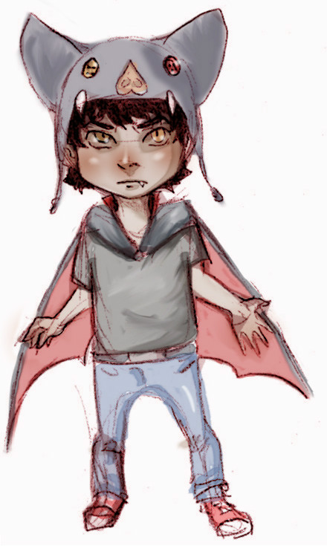
Lil Bud the Vampire
Makes a Human Friend
Vincent F. A. Golphin

Slide 2
The drawings in this book are by:
Copyright (c) 2014 The Writing Company, Ltd. All rights reserved. Published by Elephant Eye Press, a division of The Writing Company, 1969 S. Alafaya Trail #174, Orlando, FL 32828

Slide 3
To Adults
This is a First Concept read-aloud storybook designed to spark children's interest in reading, prod their use of imagination, and offer you opportunities to interact with each other and the story. Here is how to use the text.
Read the complete tale aloud to a child once. Do not worry that the book does not have illustrations. Ask the child to imagine the scenes. Read the tale a second time page by page. Point to the words, if you like, then ask the child to draw scenes on the white pages to complete the storybook.

Slide 4
Lil Bud Makes a Human Friend
Lil Bud the Vampire tried, tried, and tried,
to hold his joy and excitement, but could not hide,
the way he felt about All Hallows Eve,
when human kids roamed for what they called Halloween.

Slide 5
Lil Bud Makes a Human Friend
Bud usually hid from humans, as he traveled in the night.
The little kid never wanted to give anyone a fright.
Yet once a year came the time when he did not have to fear.
On Halloween, even to humans vampires were dear.

Slide 6
Lil Bud Makes a Human Friend
“It is almost Halloween,Mom” Lil Bud said,
as thoughts of making human friends danced in his head.
I am going to meet some new kids,” he said with glee,
Then, my playmates will be more than vampires, see?”

Slide 7
Lil Bud Makes a Human Friend
Now Lil Bud loved the other vampire kids.
He enjoyed games and the other things they did,
but he never had a human friend,
so Bud did not know where to start or end.

Slide 8
Lil Bud Makes a Human Friend
Mom listened to Lil Bud without a word of doubt,
afraid that his dream could never come about.
She thought, “Humans have reasons to stay apart,”
but did not want to break her child’s heart.

Slide 9
Lil Bud Makes a Human Friend
“That’s really nice,” she said to Lil Bud,
“If you bring a human home, make sure he likes blood.”
“Why a human friend?,” Mom’s thoughts began to roll.
“My son should make pals with a ghoul, a witch or a troll.”

Slide 10
Lil Bud Makes a Human Friend
Mom never said a word of doubt about Bud’s plan.
She decided, “Let him make a human friend, if he can.”
Her son's big heart she had to admire,
though she knew most humans might fear a vampire.

Slide 11
Lil Bud Makes a Human Friend
Humans are taught they are evil, the Living Dead.
Lil Bud knew that was just a rumor vampires spread
to keep the humans away from their fun at night.
He thought that was selfish, and knew it was not right.

Slide 12
Lil Bud Makes a Human Friend
Lil Bud’s dad and brother only saw humans as food,
and only went near them when in a hungry mood.
His brother Draco said, “Hanging around humans is weird.”
They probably have cooties and other diseases, he feared.

Slide 13
Lil Bud Makes a Human Friend
Bud asked, “What if they like games and laughs like us?
“Would there really be a need for all of this fuss?”
“Draco's never seen a human kid,” Bud said to himself.
“I bet he could not even tell a human boy from an elf.”

Slide 14
Lil Bud Makes a Human Friend
“Your brother is right,” said Lil Bud’s dad,
who became very upset, and even got mad.
“Stay away from the humans as much as you can at night.
“We have always lived that way, which makes it right.”

Slide 15
Lil Bud Makes a Human Friend
Bud listened well to his dad, and accepted the insight,
but could never see where to stay away was right.
Vampires and humans are different, Lil Bud understood,
but thought, “Isn't any new friend something good?”

Slide 16
Lil Bud Makes a Human Friend
Lil Bud dressed like a human for Halloween,
and was the funniest sight you have ever seen.
His clothes were brightly colored, but did not match,
and on the pant's right knee was a big orange patch.

Slide 17
Lil Bud Makes a Human Friend
He breezed through the streets, ran door to door.
Lil Bud filled a bag with candy, but wanted something more.
Down a dark street he walked in search of a friend,
and a funny little accident happened right then.

Slide 18
Lil Bud Makes a Human Friend
In the thick, dense fog in that part of town,
Bud bumped into a human boy, and they fell down.
“Are you Ok?” Lil Bud asked, as the kid rubbed his head.
“Yes, but my candy spilled all over,” the boy said.

Slide 19
Lil Bud Makes a Human Friend
They picked up the Halloween treats, and stuffed them in bags,
The human kid looked like a TV vampire, but dressed in rags.
His black cape was shredded, and the suit did not fit well,
Yet he was excited to play the role, as far as Bud could tell.

Slide 20
Lil Bud Makes a Human Friend
“What are you?” Lil Bud asked, as they began to stand.
“I'm a vampire,” the boy said, then stuck out his hand.
They shook hands, traded names, and began to walk together.
At last, Lil Bud met a human; his spirits soared like a feather.

Slide 21
Lil Bud Makes a Human Friend
“I know all about vampires,” said Bud’s new friend.
“Really?” Lil Bud said to Evan. “Tell me about them, then.”
“Well, they eat blood, dress in black, and turn into a wolf or bat.”
“Really?” Bud replied, and wanted to laugh, “Imagine that.”

Slide 22
Lil Bud Makes a Human Friend
“Yeah,” Evan said. “If you ever see one, better run or die.
“Vampires can move really fast, and sometimes they even fly.”
“So you never want to meet a vampire?” Lil Bud asked,
and decided to hide his secret since Evan never asked.

Slide 23
Lil Bud Makes a Human Friend
“I'd loved to meet one,” Evan said, “if he did not bite.
“I like being a little boy, not a ‘creature of the night.’”
“Creature?!!” Bud screamed, as his eyes grew wide.
“Whoever taught you stuff about vampires, really lied.”

Slide 24
Lil Bud Makes a Human Friend
Bud said, “If you want to know the truth, we can become friends.”
Evan stood silent, stared and thought, “I wonder what he intends.”
Evan said, “You mean you won't drink my blood, or even bite?”
Lil Bud laughed,”Of course not, silly, that wouldn’t be right.”

Slide 25
Lil Bud Makes a Human Friend
From that night on each boy learned about the other's life.
Evan played with Bud after dark; and there was no strife.
Mom said, “That’s nice!” Dad said nothing more.
Brother Draco said, “That’s something no vampire’s done before.”

